Slide 1

New Generation Mobile Networks: How to break the energy curve?
Hicham Khalifé,
Joint work with Khoa Dang, Mathias Sintorn, Dag Lindbo, Ericsson Stéphane Rovedakis, Stefano Secci, Cnam
Green Days
Rennes Mars 2025

Slide 2
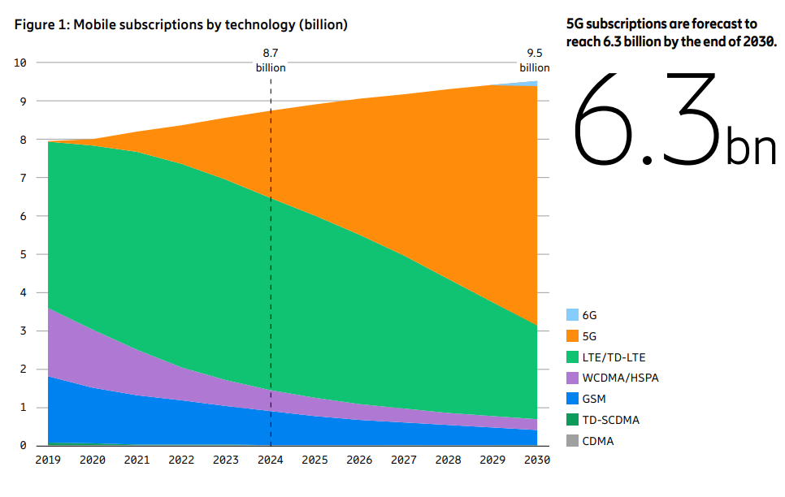
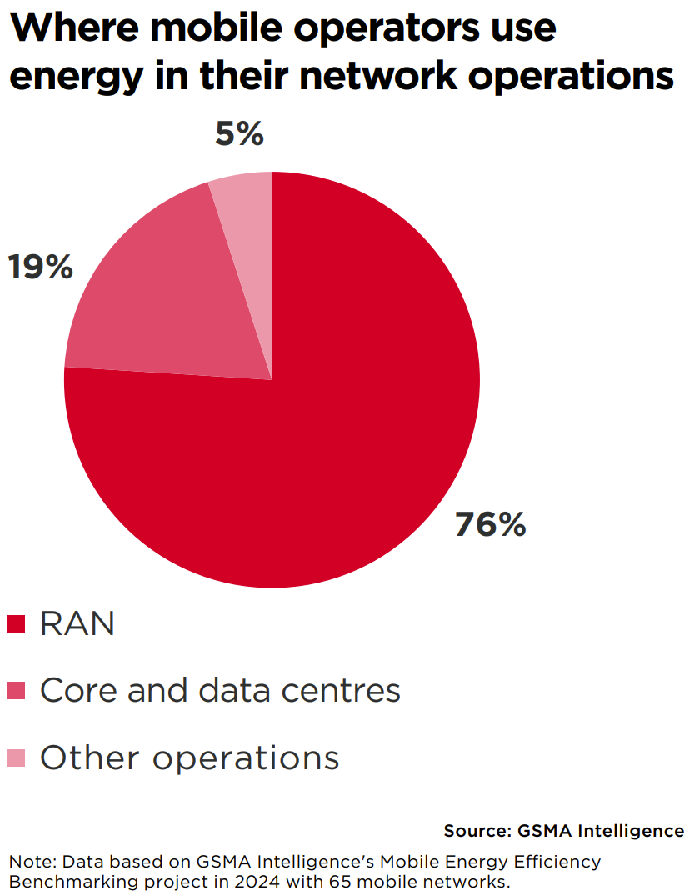
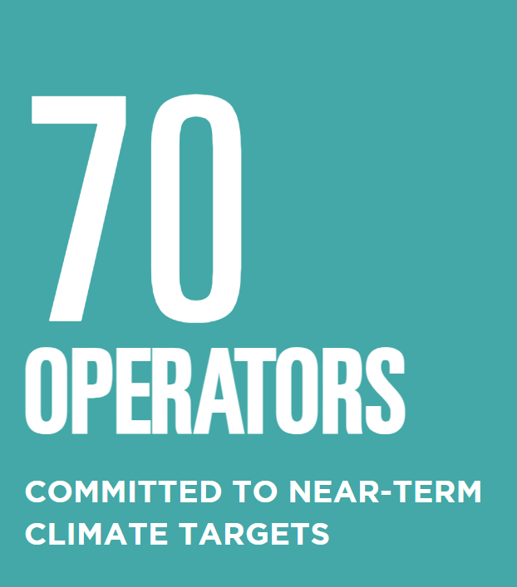
Introduction and Motivation
GSMA. Mobile Net Zero 2024:
State of the Industry on Climate Action
ericsson.com/mobility-report
GSMA Intelligence. Going green: measuring the energy efficiency of mobile networks (2024)

Slide 3
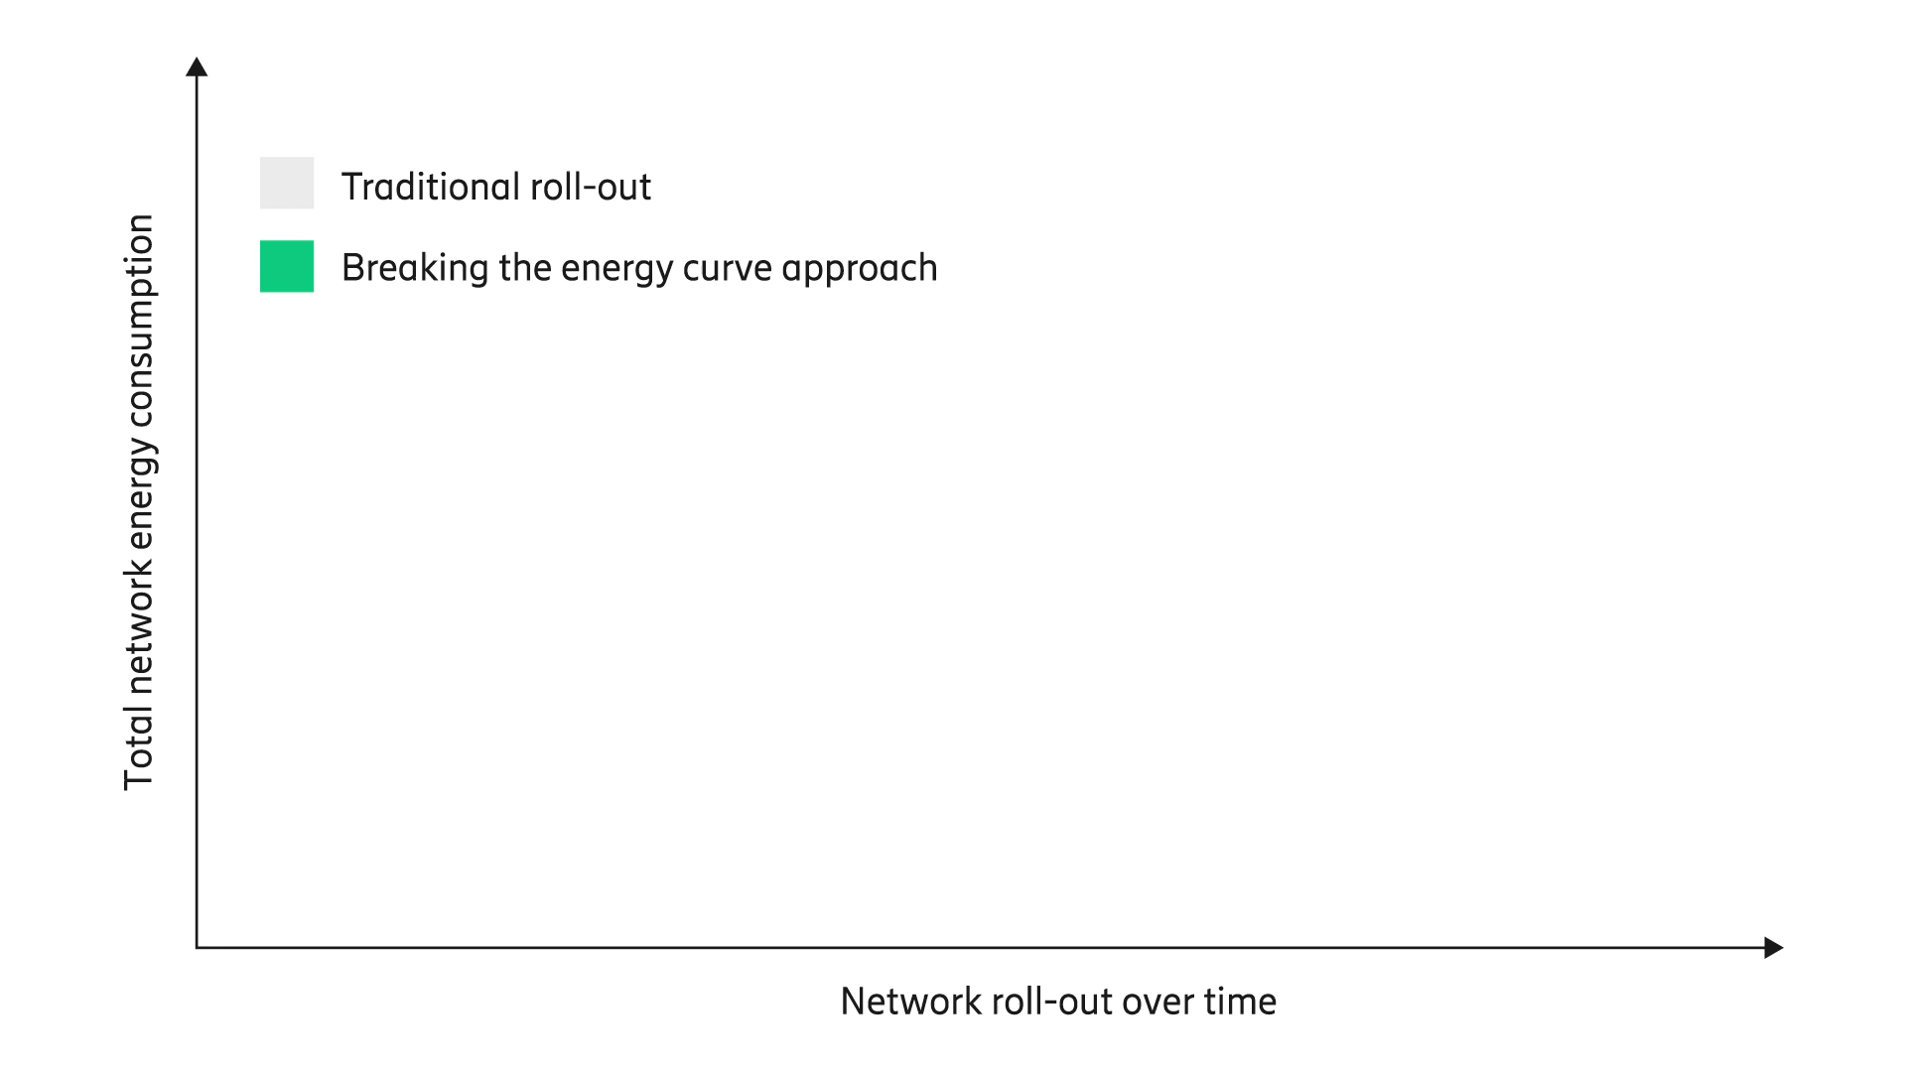
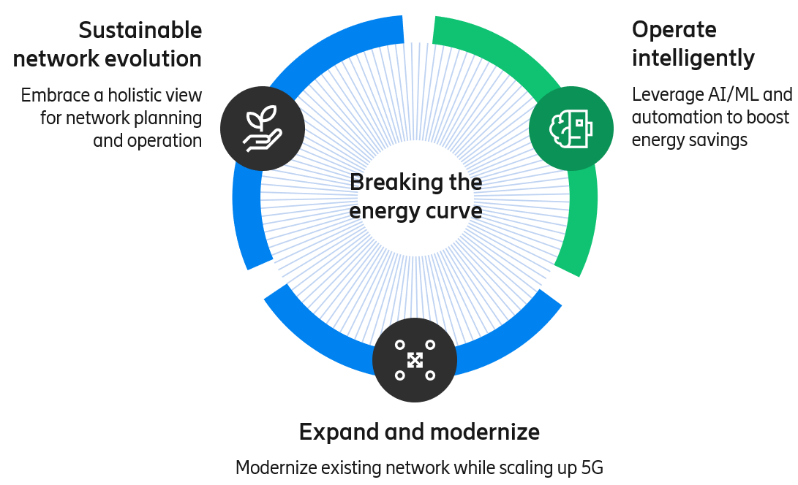
Breaking the energy curve
ericsson.com/
breaking-the-energy-curve
What are effective ways to dynamically switch mobile network components based on varying traffic demands?
1
Research Questions
for Operating Intelligently
Can we do that without impacting users performance?
2
How can energy-saving actions be integrated with existing complex strategies that manage traffic distribution between cells?
3

Slide 4
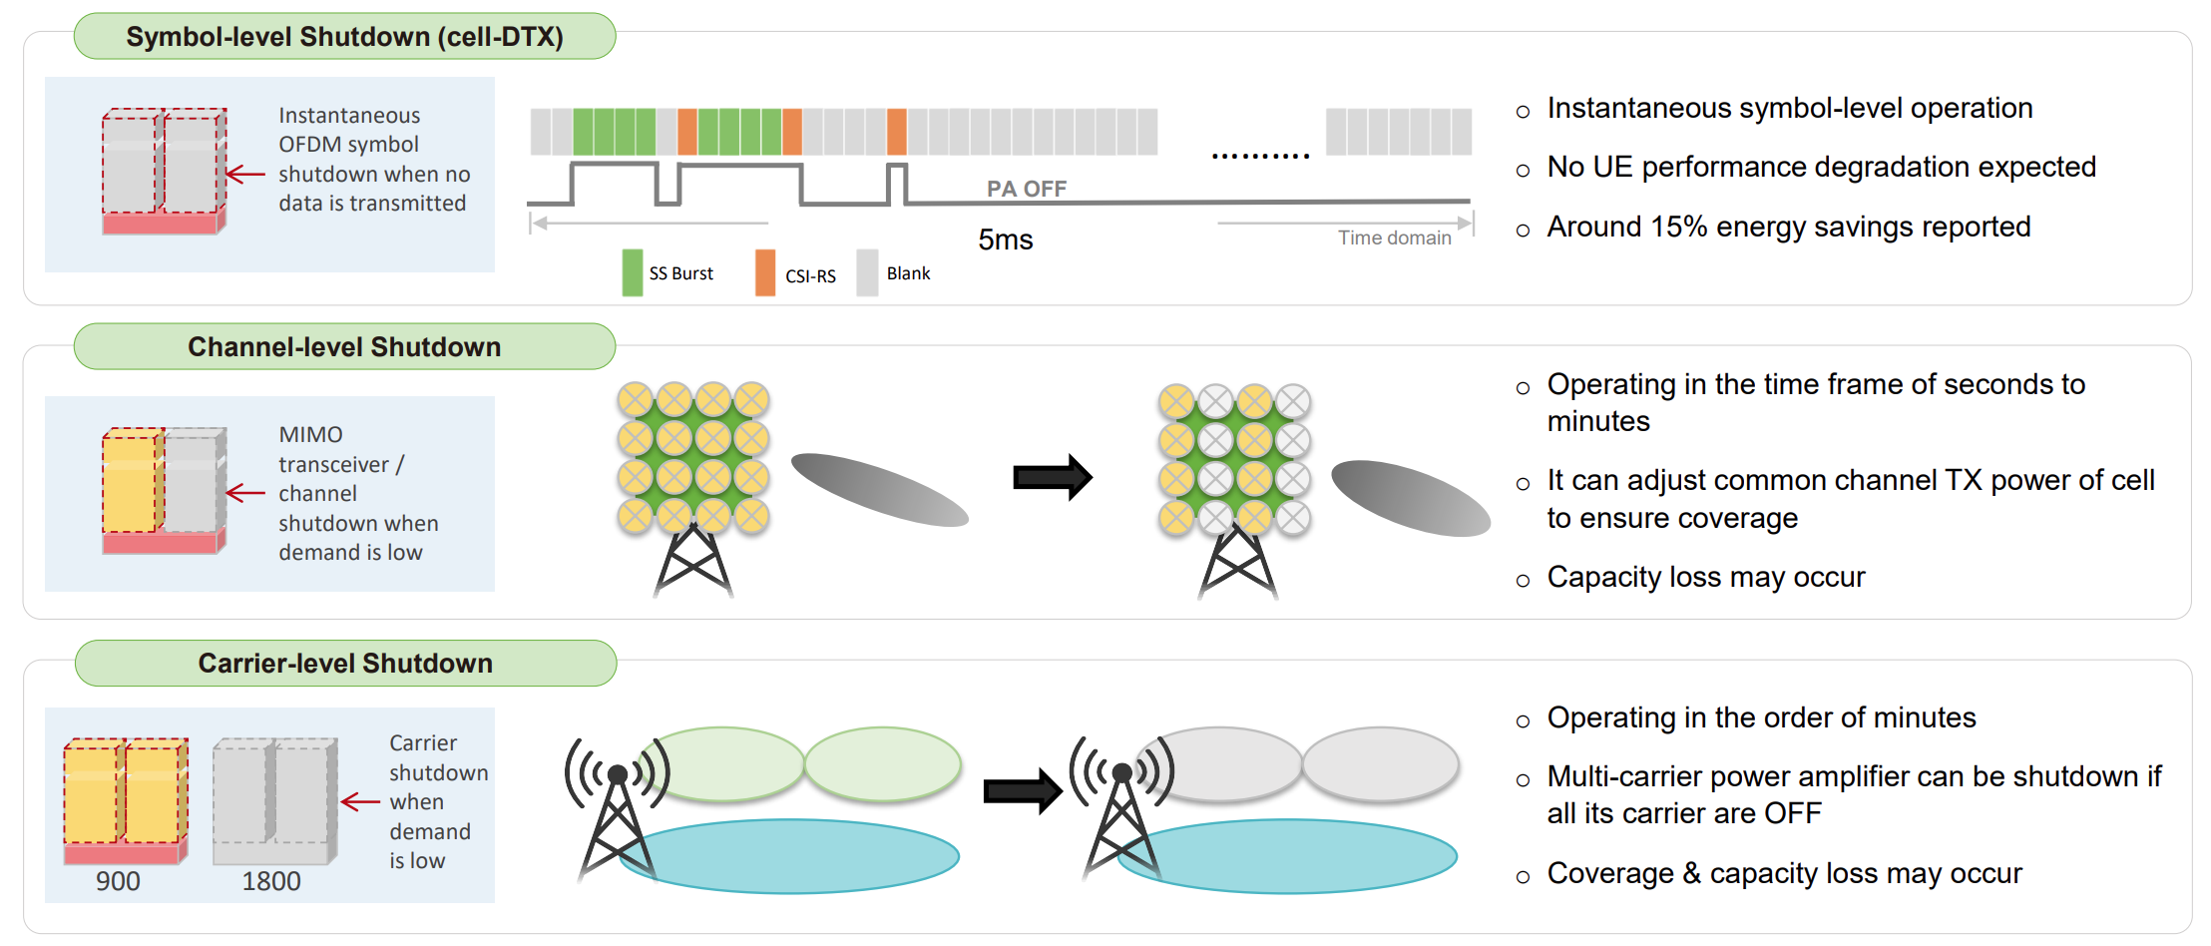
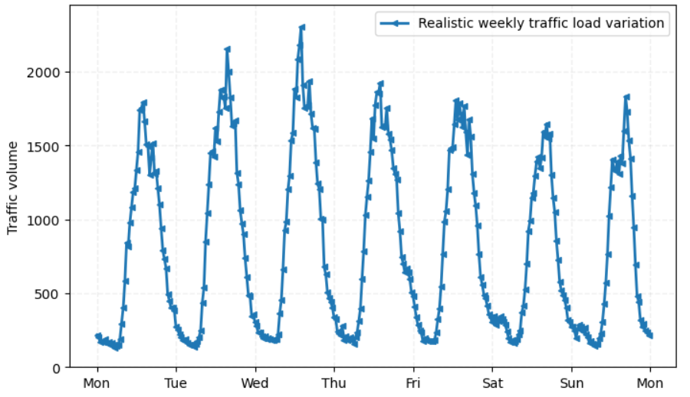
What and when to turn off 3GPP [1][2]
Peak hours
Source: Telecom Italy
Midnight
Scope of this presentation
Source: Breaking The Energy Consumption Growth In Future Mobile Networks:
5G Enhancements And Machine Learning (IEEE ICC 2022 Tutorial)
[1] 3GPP TR 38.864 , “Study on network energy savings for NR (Release 18)”, v.18.1.0, 2023
[2] D. Lopez et al. “A Survey on 5G Radio Access Network Energy Efficiency: Massive MIMO, Lean Carrier Design, Sleep Modes, and Machine Learning”, IEEE Surveys and Tutorials, 2022

Slide 5
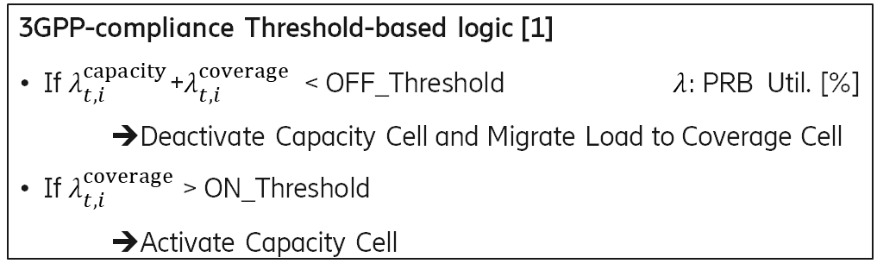
More on carrier shutdown
site
Classic Carrier Shutdown (CS) solution implemented in today network:
  Timer-based or Threshold-based solution for turning on and off carrier(s)
  For threshold approach, 2 tunable parameters manually configured by operator:
  Question: What is the impact on the performance and user experience?
➔ Can CS solution be enhanced with AI to be more flexible with varying traffic pattern and guarantees UX?
Capacity carrier
Coverage carrier
3GPP-compliance Threshold-based logic [1]
If $λ_{t,i}^{capacity}$+$λ_{t,i}^{coverage}$ < OFF_Threshold $λ:$PRB Util. [%]
  ➔Deactivate Capacity Cell and Migrate Load to Coverage Cell
  If $λ_{t,i}^{coverage}$> ON_Threshold
    ➔Activate Capacity Cell
2.6GHz 20MHz
2.1GHz 15MHz
1.8GHz 20MHz
                0.8GHz 10MHz
                0.7GHz 10MHz
[1] López-Pérez, David, et al. "Data-driven Energy Efficiency Modelling in Large-scale Networks: An Expert Knowledge and ML-based Approach." IEEE Transactions on Machine Learning in Communications and Networking (2024).

Slide 6
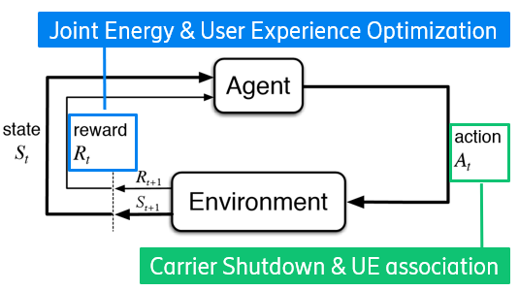
Our problem formulation
Capacity carrier
Consider a single sector within a site have multiple frequency layers:
  2 coverage (low-band) layers: 0.7, 0.8 GHz
  3 capacity (mid-band) layers: 1.8, 2.1, 2.6 GHz
Given real dataset from operator, metrics per layer can be utilized:
  Number of RRC (UE)
  Number of PRB Utilization (Load)
  UE DL Throughput distribution (To Measure UX Performance)
The objective is a ML approach for Carrier Sleep with better gain than Threshold-based approach:
  Directly deactivates capacity carriers
  Distribution of UE to the remaining active carriers
  User Experience guarantees
Coverage carrier
2.6GHz 20MHz
2.1GHz 15MHz
1.8GHz 20MHz
                0.8GHz 10MHz
                0.7GHz 10MHz

Slide 7
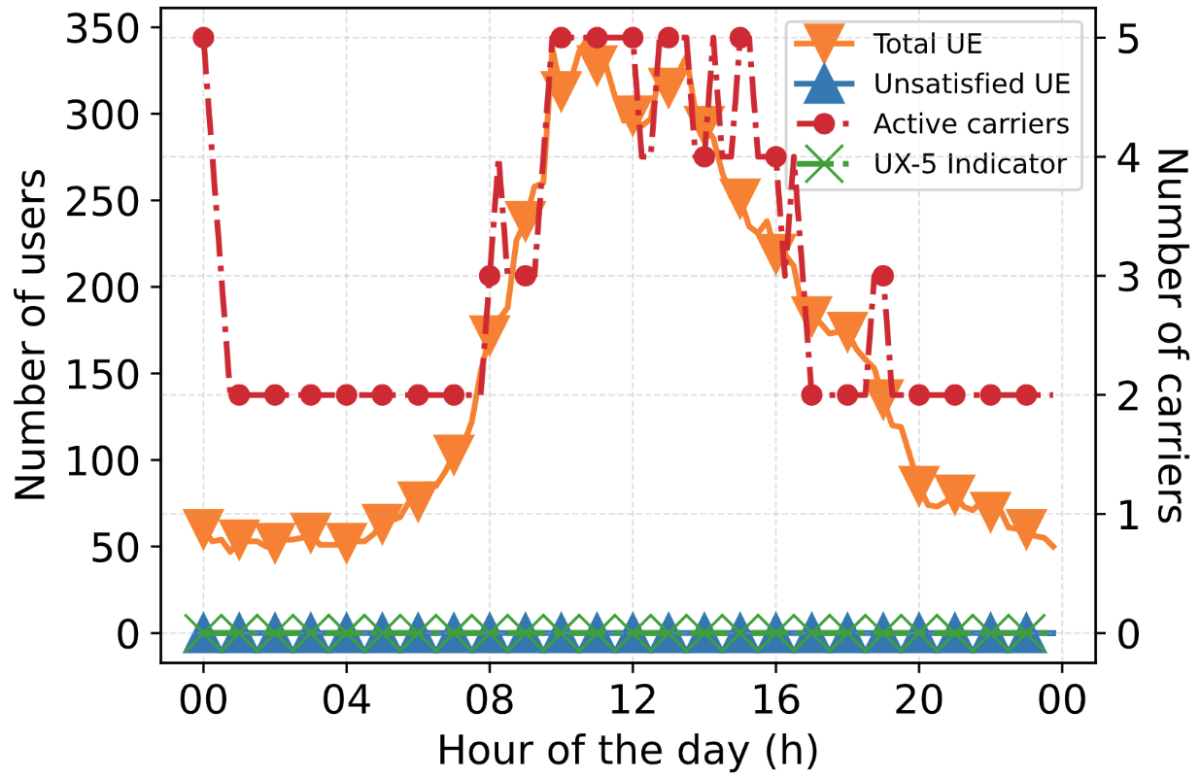
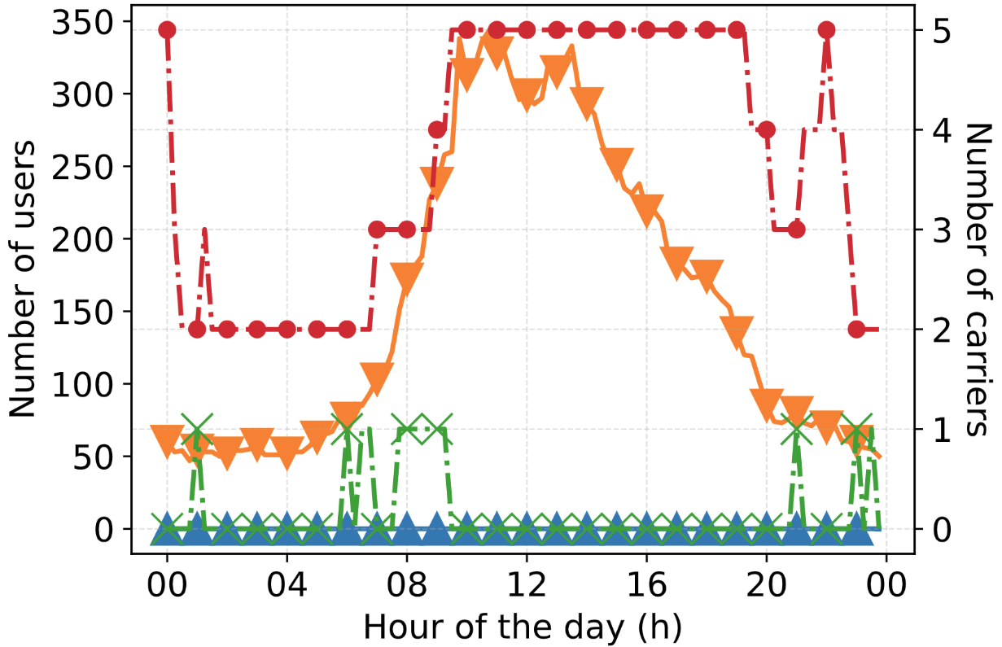
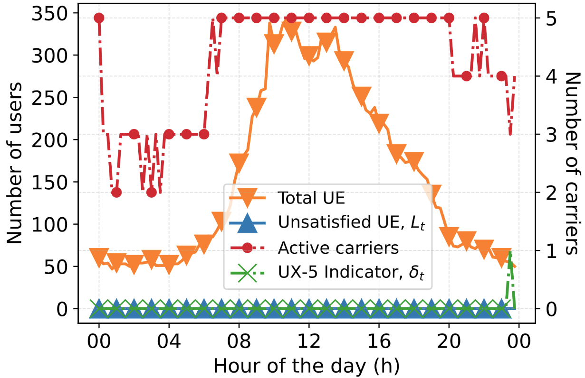
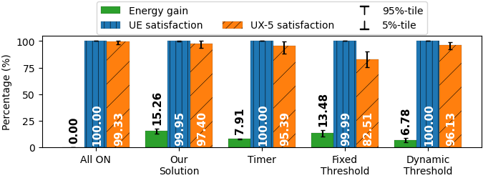
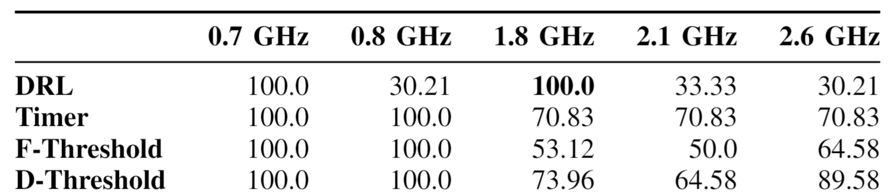
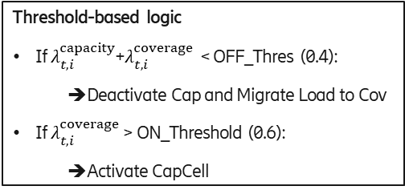
Result with real deployment
PPO is trained on 3 weeks and test on 2 weeks
Threshold-based logic
If $λ_{t,i}^{capacity}$+$λ_{t,i}^{coverage}$ < OFF_Thres (0.4):
  ➔Deactivate Cap and Migrate Load to Cov
  If $λ_{t,i}^{coverage}$> ON_Threshold (0.6):
    ➔Activate CapCell
Single day behavior
DRL
Fixed Threshold
Dynamic Threshold
2-week generalization
Single day carrier up-time (%)

Slide 8
Concluding remarks
Breaking the energy curve in mobile is a long journey requiring a holistic approach
The solution presented focuses on RAN, a long time scale solution (carrier shutdown)
Many existing solutions are complementary
  The need for a holistic approach
Then, What about the next Gs?
More reading
[1] Data-driven Energy Optimization in Mobile Networks with User Experience Guarantees, Anh-Khoa Dang, Hicham Khalife, Mathias Sintorn, Stephane Rovedakis, Stefano Secci, IEEE Infocom 2025
[1] 'Energy Optimization for Multi-Band Cellular Networks: a Traffic Prediction-Based Strategy, Anh-Khoa Dang, Hicham Khalife, Stephane Rovedakis, Stefano Secci, Mathias Sintorn, IEEE ICMLCN 2025
[2] Deep Reinforcement Learning for Joint Energy Saving and traffic Handling in xG RAN, Khoa Dang, Hicham Khalifé, Mathias Sintorn, Dag Lindbo, Ericsson Stefano Secci, IEEE ICC 2024

